Slide 1
An agentic ML advisor that works the way the book does
Machine learning guidance from Lindholm et al., chapters 2, 3, 4 and 13 — with the Heart Failure analysis as a worked example
Florentine Mukamana · CoRE AI research visit · October 2026
Notes:
This talk explains the agentic ML advisor: what it is for, how it works, and what it did on a real analysis. Everything shown comes from the files in the workspace; the 'screenshots' are renders of real excerpts, each labelled with its source.

Slide 2
The aim: a report the book's authors would recognise
An AI agent works through a supervised ML problem with the user, one step at a time.
Every rule it follows is judged by one test: is this how Lindholm, Wahlström, Lindsten and Schön would work?
1
Predict, don't explain
The aim is the output for new cases, not how variables are connected (p. 20)
2
Define the problem first
Validation and test data, one metric and a baseline, agreed before any model (pp. 327–331)
3
Start simple
Add complexity only when the errors call for it (pp. 331–337)
4
Compare by cross-validation, test once
The chosen model meets the test set a single time (pp. 72–74, 328)
Machine Learning – A First Course for Engineers and Scientists, 2nd ed. (smlbook.org)
5
Report E_new
An average-case estimate on data like the evaluation data (pp. 68–69, 347)
Notes:
The Purpose section of instructions.md: the work should end in a report consistent with how the book's authors would work. These five principles come from ML Guide.md Part I, with the book's page numbers.

Slide 3
Four parts, each with one job
The user
Directs every step, answers the questions only they can answer, makes every call
The agent
Claude Code, bound by instructions.md and ML Guide.md: asks, explains, checks, writes the records
The deterministic core
Python / scikit-learn: properties, admissible set, prior ranking, nested CV, recommendation
The records
Appendix.md: Decision Records and log. Report.md: built up step by step
Rules propose, cross-validation decides, the trace explains. The agent never computes the mechanical parts itself: it passes inputs to the core and copies the outputs into the records unchanged, with the code's SHA-256.
Notes:
ML Guide.md §7. Until Code/advisor/ is built, each analysis has an interim core (Code/sepsis/core.py), shown to the user before its first output is used and labelled 'interim core, not reviewed'.

Slide 4
Five steps, one at a time, closed by the user
1
2
3
4
5
Import and scope
Provenance, units, missing data, leakage; admissibility questions
Define the problem
Target, metric, baseline, success criterion; test set locked
Explore training data
Input design, P9–P10 from the core, figures
Select, train, evaluate
Admissible set, prior, nested CV, diagnosis, one test
Conclusions
What the results support, and what they do not
Each step ends with a written check: what is settled, what was never discussed — then the agent waits. All five were completed on Heart Failure.
Notes:
From instructions.md, The Five Steps. The agent asks 'have we thought of everything in step 2?' rather than 'shall we move on?'. The Heart Failure analysis went through all five; the Sepsis analysis has closed steps 1 to 3.

Slide 5
Every rule says how much of it is the book's
[B]
Explicit book advice
e.g. split by group where rows share a unit (p. 329)
Evidence tags on every value
M metadata or the user (from step 2) · T training data (step 3) · CV cross-validation (step 4) · TEST the single final evaluation
[B→I]
A book fact we turned into advice
e.g. the imbalanced diagnosis error (p. 91)
A small, fixed solution space
14 configurations from chapters 2–3: k-NN, decision tree, linear, logistic, Poisson and exponential GLMs, with polynomial terms and L2 where allowed. Anything else is flagged, never used.
[I]
Our own inference or threshold
e.g. P10 imbalanced if smallest class < 20 %
Notes:
ML Guide.md §8 and §9. Tags are copied into Decision Records unchanged and never upgraded, so a reader can count how much of a recommendation rests on the book and how much on our own thresholds.

Slide 6
Worked example: death during heart failure follow-up
Heart Failure Clinical Records, UCI (2020): NYHA class III–IV patients, two hospitals in Faisalabad, Pakistan, 2015
299
patients in the file
239 / 60
training / test patients
32.2 %
of training patients died
F2
one metric for model, threshold and success
Notes:
The finished reference analysis, Demonstration/Heart Failure. The user's problem: 'Flag heart failure patients at high risk of dying during follow-up, so they can be monitored more closely.' Eleven inputs; follow-up time is in the file but not used, because it ends when the outcome happens.

Slide 7
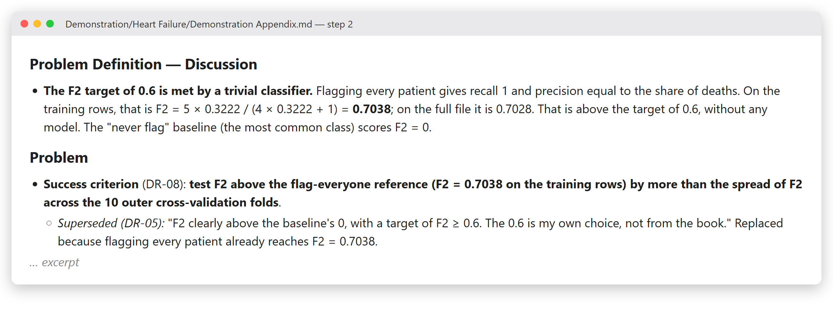
Step 2: the problem is fixed before any model
Prediction, not explanation
"The aim is prediction for new patients, not explaining causes" (ADM-2, p. 20).
One metric
F2 counts recall twice as heavily as precision: a missed death costs more than a false alarm (p. 92).
A weak target caught
Flagging everyone already scores 0.7038, so the target of 0.6 was replaced before any model.
Render of Demonstration/Heart Failure/Demonstration Appendix.md, Problem Definition (excerpt).
Notes:
The test set was locked at the end of step 2: 60 patients, stratified by outcome, seed 2026. The success criterion is test F2 above flag-everyone (0.7038 on the training patients) by more than the fold spread of F2.

Slide 8
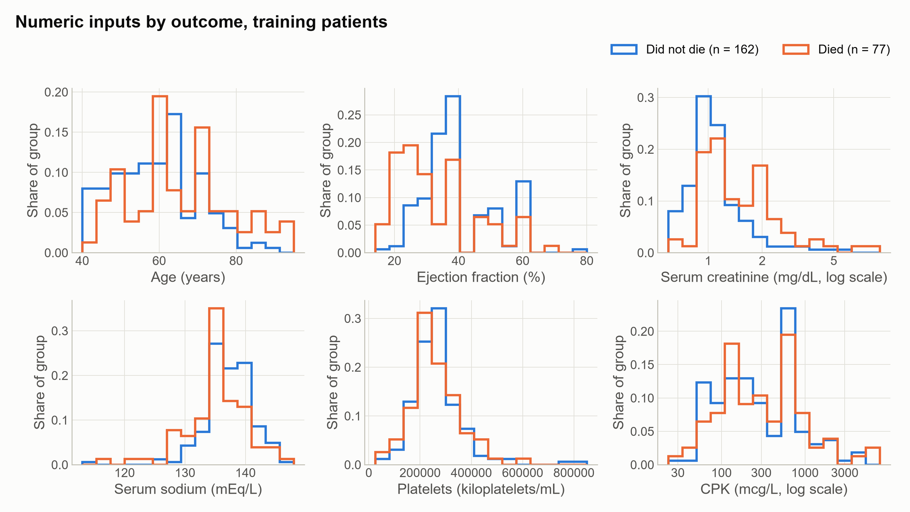
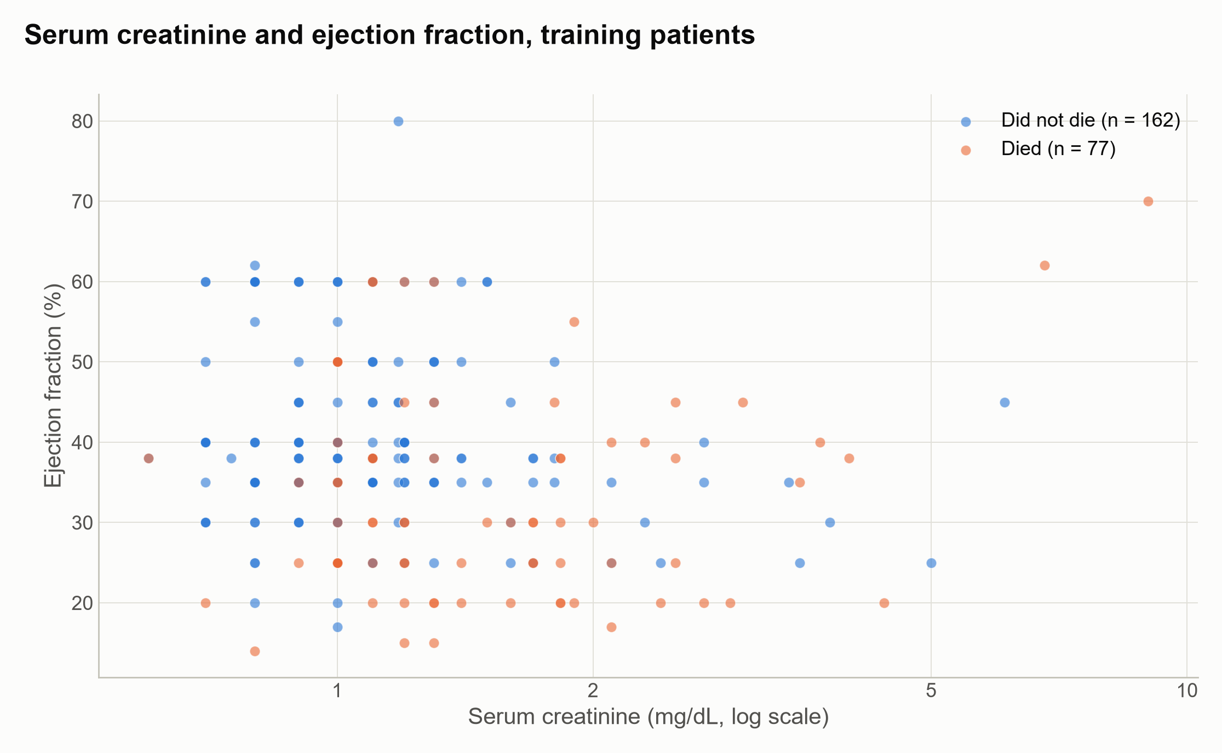
Step 3: the training data, before any model
Blue: no death; orange: died. 239 training patients; the 60 held-out patients are not shown. The user expected higher creatinine and lower ejection fraction to go with risk — a direction, recorded in their words, not a shape, so P8 stays unknown.
Figures 1 and 3 of Demonstration/Heart Failure/Demonstration Report.md.
Notes:
Serum creatinine and creatinine phosphokinase enter every model as logarithms (DR-11, the user's decision). Figures never set the expected shape of a relationship.

Slide 9
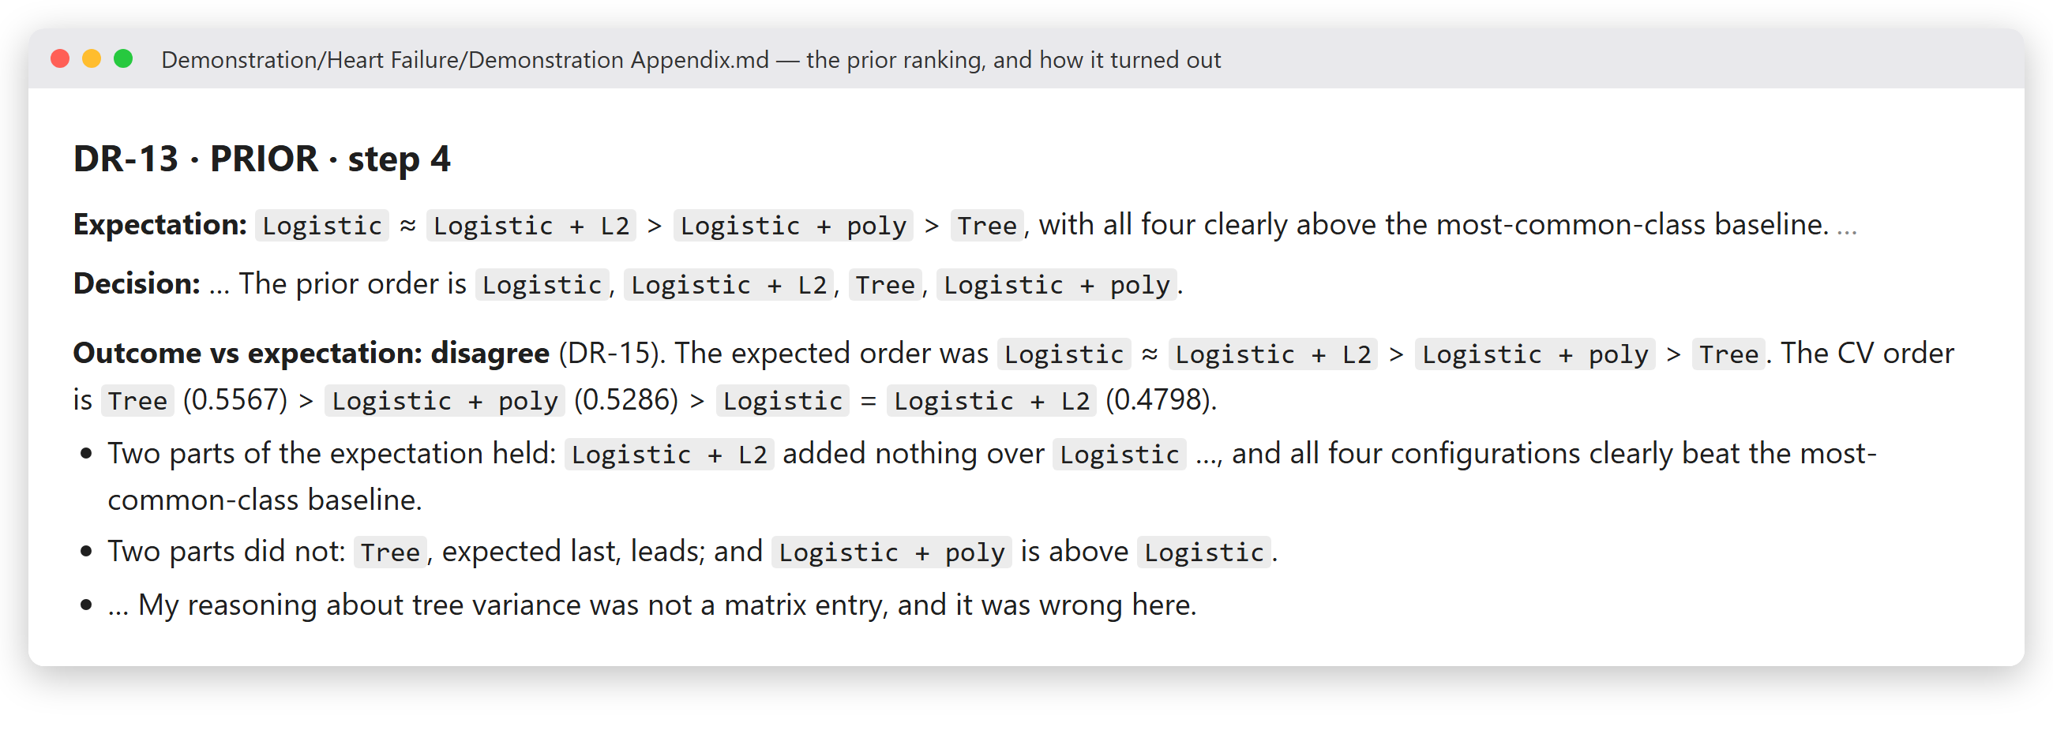
The prior records an expectation — this one was wrong
Rules propose
The ranking kept the baseline, plain logistic regression and the three highest-ranked others.
Cross-validation decides
The tree, expected last, came first.
Recorded, not explained away
The disagreement is a finding; the record says which reasoning was wrong.
Render of Demonstration/Heart Failure/Demonstration Appendix.md, DR-13 (excerpt).
Notes:
The prior entries that favoured logistic regression concern inspectability and probabilities, not predictive fit, so the disagreement on F2 does not contradict them.

Slide 10
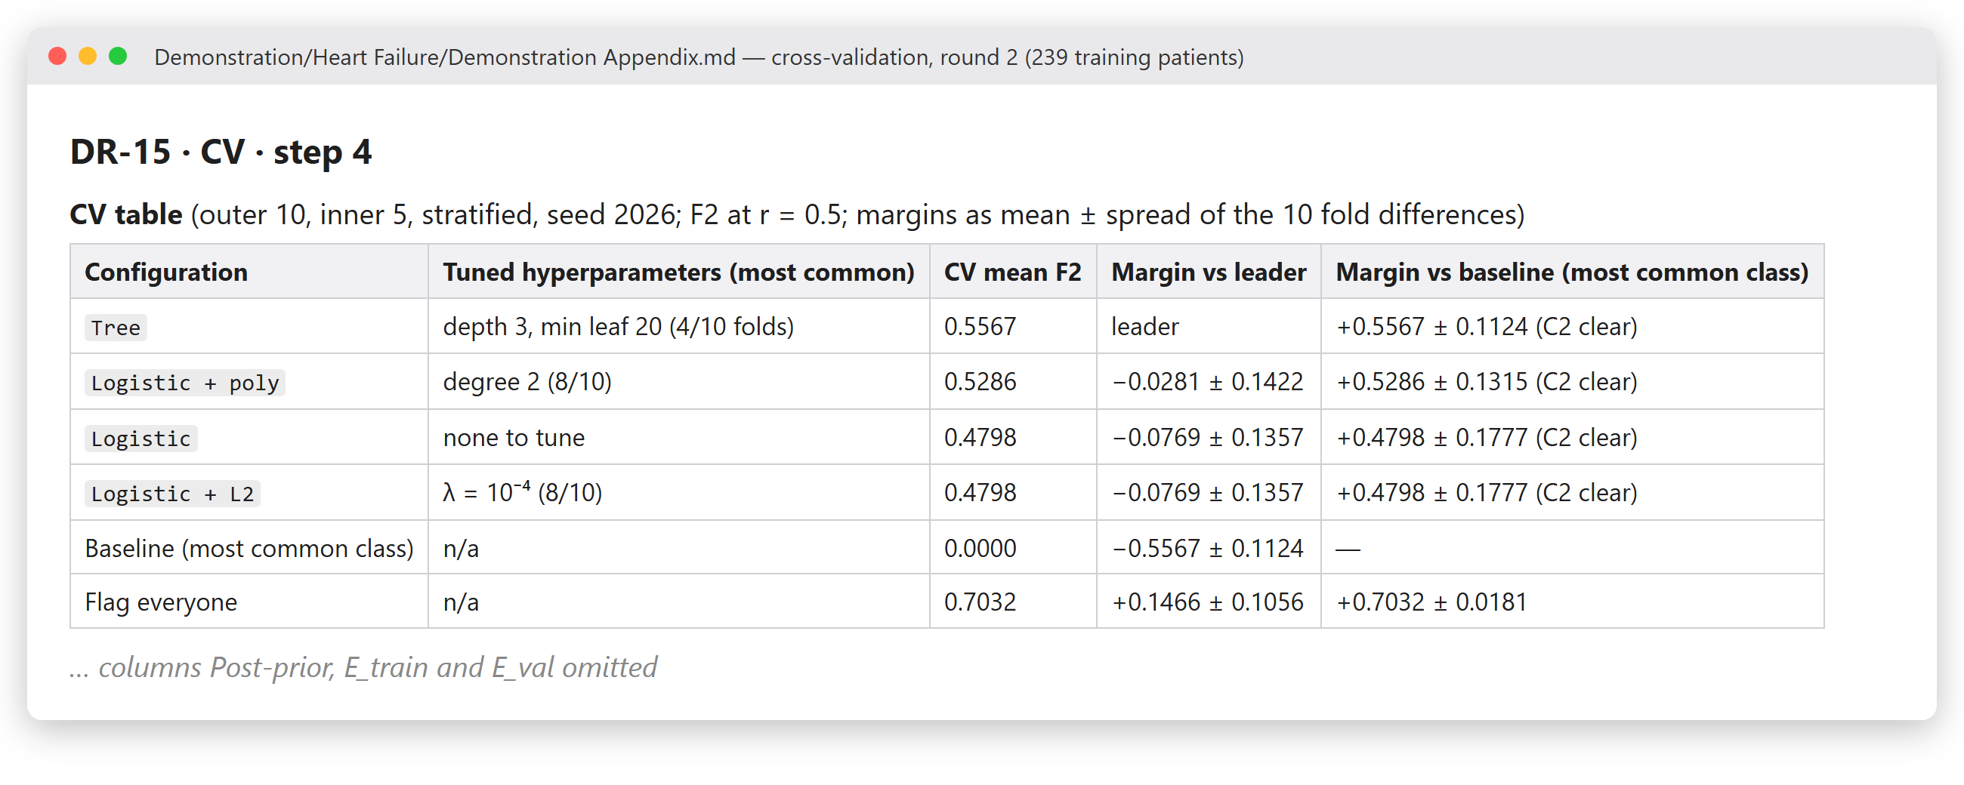
Cross-validation decides; simplicity breaks the tie
1
Tree vs Logistic + poly
0.5567 vs 0.5286: a difference of 0.03 against a fold spread of 0.14
2
Can't be told apart
below half the spread (§19), so the one with fewer add-ons wins: the tree (p. 332)
3
Selection confidence: Low
clear over the baseline, but not over the runner-up
Render of Demonstration/Heart Failure/Demonstration Appendix.md, DR-15 (excerpt).
Notes:
Nested cross-validation: 10 outer folds, the same for every configuration; 5 inner folds tune depth, leaf size, penalty and degree. Models compared on F2 at a threshold of 0.5. Flag-everyone scores 0.7032 in cross-validation.

Slide 11
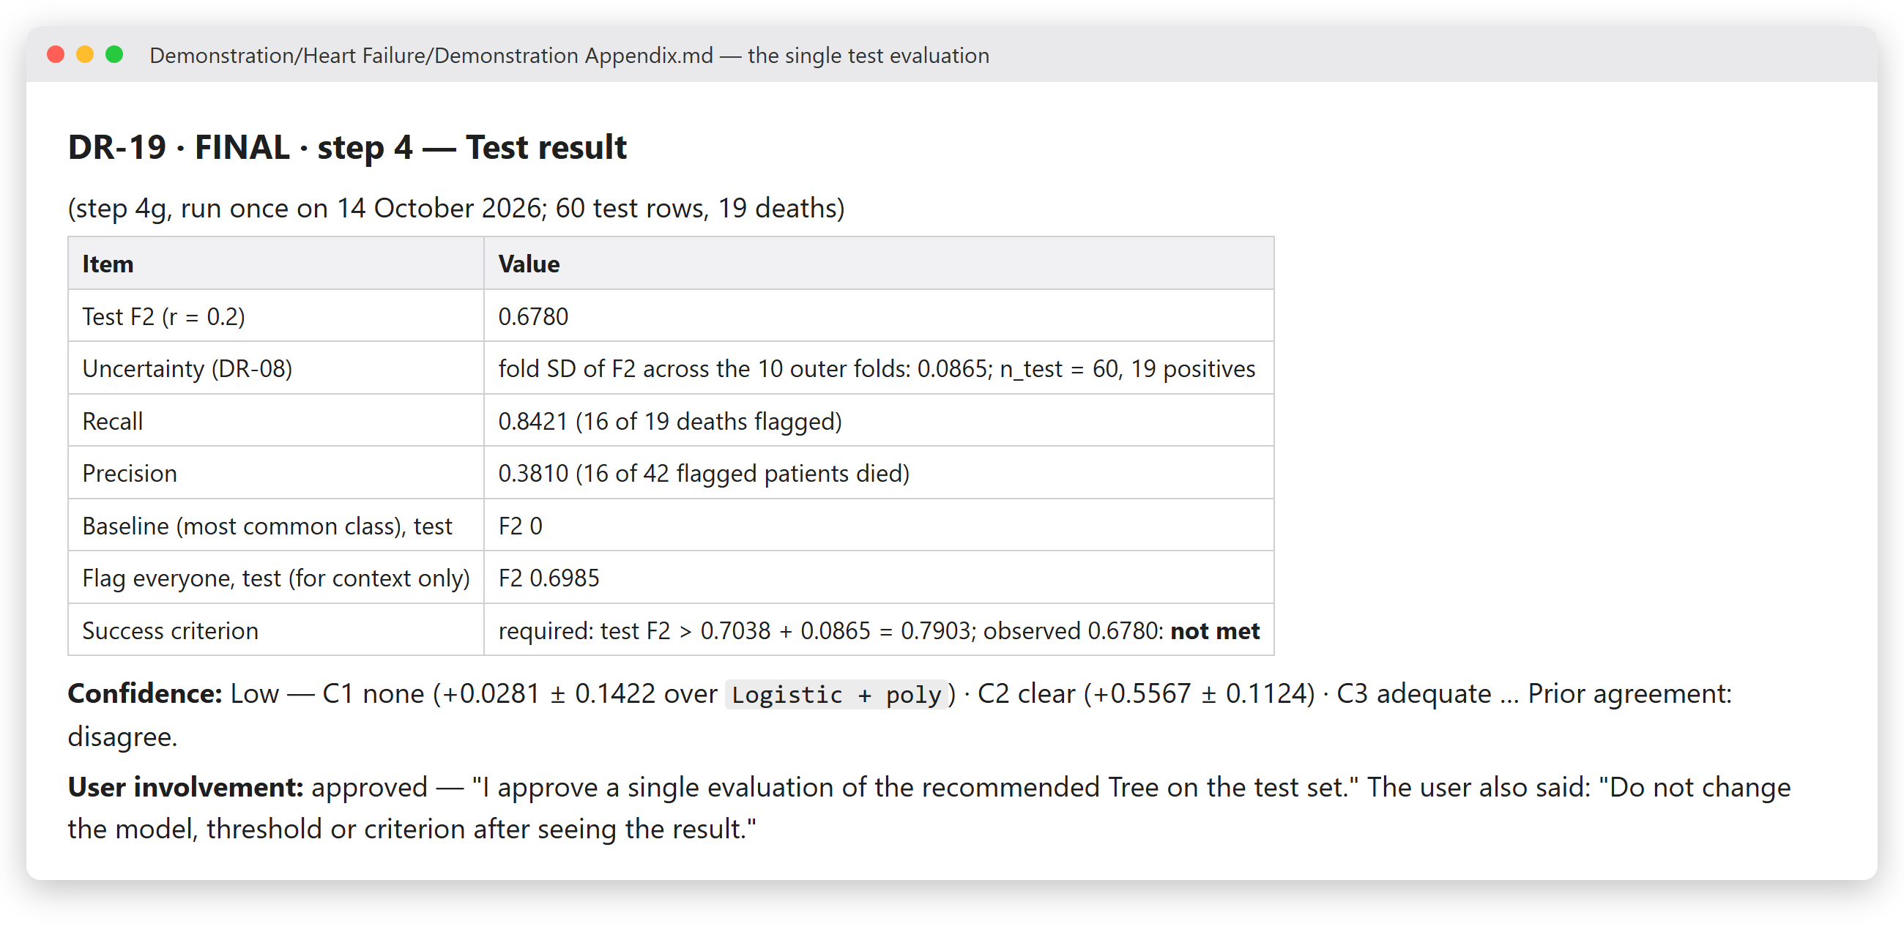
One test, approved by the user, reported as found
Approved first
The test set was used once, only after the user approved it.
Checked twice
The test F2 was recomputed independently from the saved predictions.
Nothing moved after
"Do not change the model, threshold or criterion after seeing the result."
Render of Demonstration/Heart Failure/Demonstration Appendix.md, DR-19 (excerpt).
Notes:
The final tree: depth 3, at least 20 patients per leaf, threshold 0.2 chosen from out-of-fold probabilities on the training patients only.

Slide 12
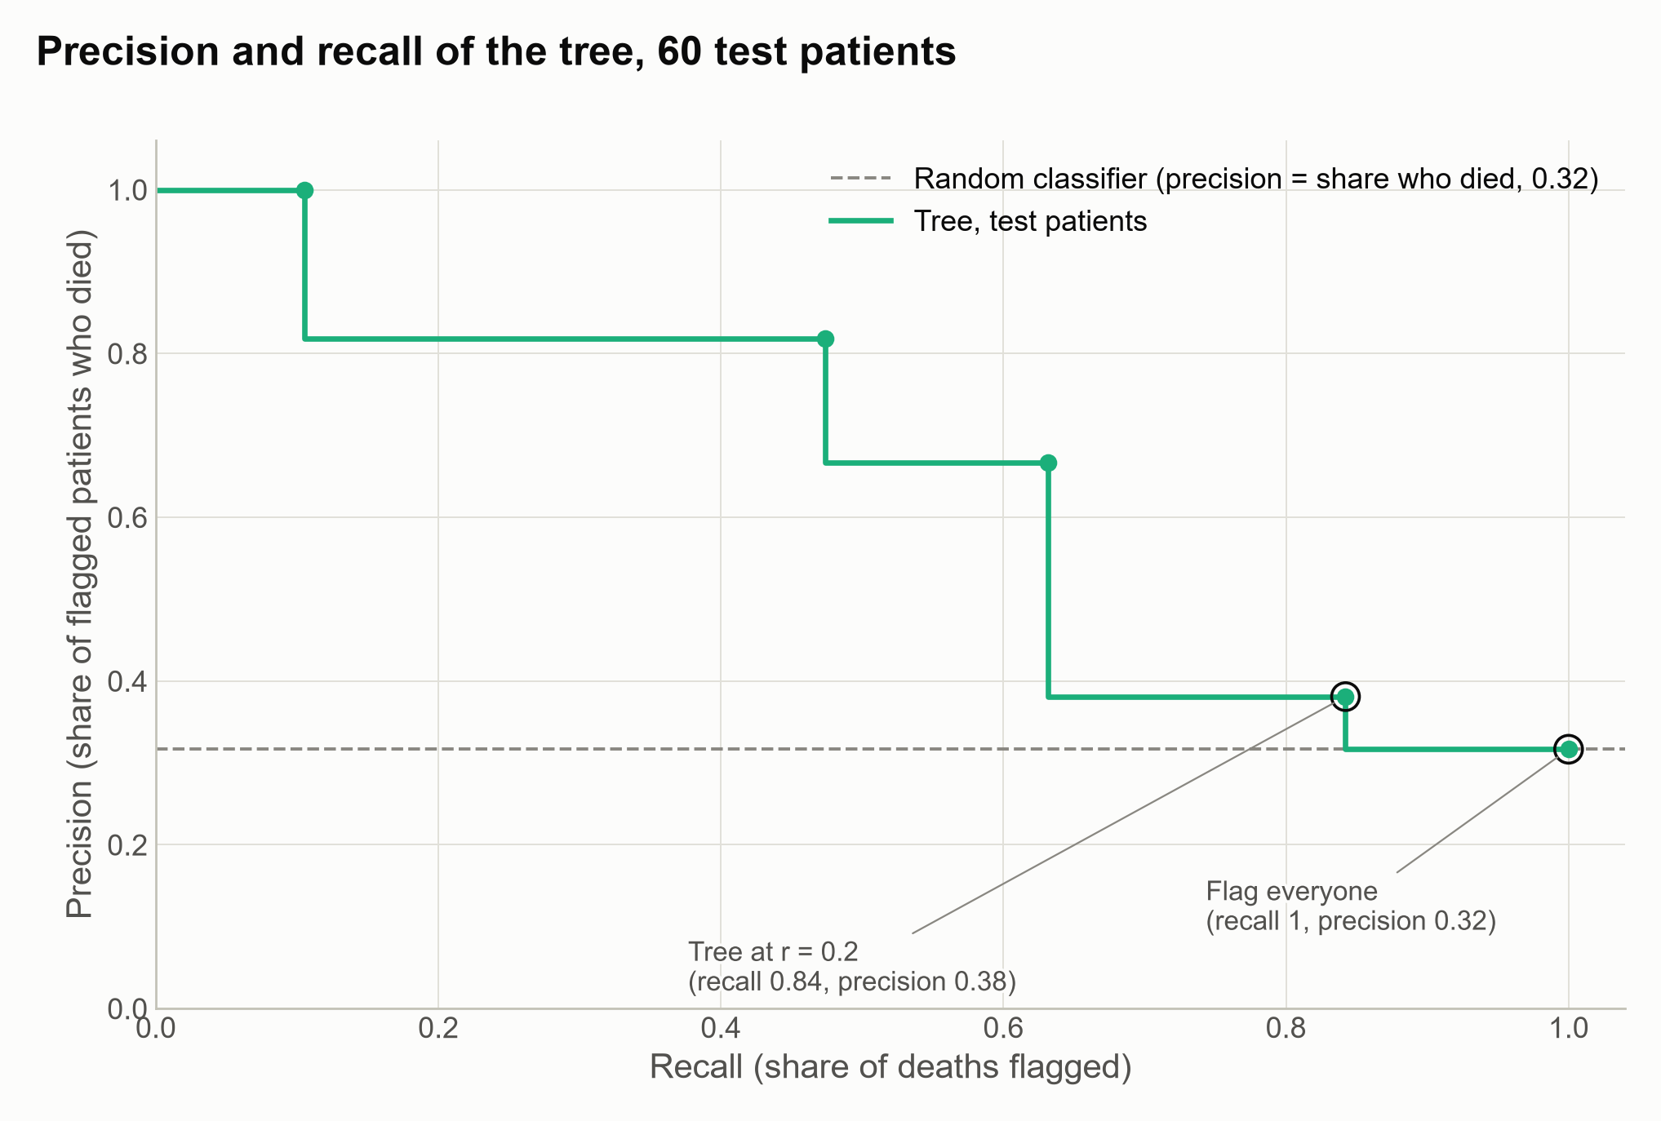
The success criterion was not met — and the report says so
0.68
test F2 of the tree (fold spread 0.09)
0.70
test F2 of flagging every patient
16 of 19
deaths flagged (recall 0.84)
16 of 42
flagged patients died (precision 0.38)
Success needed F2 above 0.79. With 19 deaths among 60 held-out patients, only large differences in F2 can be detected. The result is an average over patients like these; it says nothing about the worst individual prediction (p. 347).
Figure 4 and Results of Demonstration/Heart Failure/Demonstration Report.md.
Notes:
The required F2 was 0.7038 plus the fold spread 0.0865, i.e. 0.7903. The tree flags 42 of 60 patients; in practice it differs from flagging everyone only through one low-risk group, which the held-out patients do not show to be safe.

Slide 13
Where it stands
Heart Failure: all five steps done; kept as the reference
Sepsis (PhysioNet 2019): steps 1–3 closed; it prompted one FRAMEWORK change, the diagnosis error for imbalanced classes (p. 91)
Next: Sepsis step 4, then the Mobile Price dataset
Then: build Code/advisor/ from the interim cores
Notes:
Each dataset is used to move the method closer to the book: where the contract or the guide leads to something the authors would not do, it is changed under FRAMEWORK and the change is logged in the analysis that prompted it.

